Slide 1
Fake Job Posting Prediction
CHARAN NAGA SRI SAI SATYA GANNAPUREDDY
Notes:
“Hello everyone.
My name is Charan Naga Sri Sai Satya Gannapureddy, and today I will be presenting my project titled Fake Job Posting Prediction.
With the increasing use of online job portals, job searching has become easier than ever. However, this convenience has also opened doors for scammers who post fake job listings to exploit job seekers.
In this project, I focus on using data science, machine learning, and natural language processing techniques to identify fraudulent job postings and help improve trust and safety on online hiring platforms.”

Slide 2
Problem Statement
Online job portals are increasingly targeted by scammers who post fake job listings to steal personal information or money. These fraudulent postings harm job seekers and reduce trust in hiring platforms. The goal of this project is to build a machine learning model that can automatically detect fake job postings using text and metadata. The study also aims to understand which features most strongly differentiate real and fraudulent postings.
Notes:
“Online job portals are increasingly targeted by scammers who post fake job listings.
These fraudulent postings often aim to steal personal information, money, or both.
This problem affects job seekers emotionally and financially, and also damages the credibility of hiring platforms.
Fake job postings are often designed to look legitimate, which makes manual detection very difficult.
The main goal of this project is to build a machine learning model that can automatically detect fake job postings using both textual content and metadata.
Another important objective is to understand which features most strongly differentiate real job postings from fraudulent ones.”

Slide 3
Methdology
Data Collection
The dataset is gathered from the Kaggle “Real or Fake Job Posting” source, containing job postings with text, metadata, and labels indicating whether each posting is real or fraudulent.
Data Preprocessing
Missing values are handled appropriately, and categorical or binary fields are cleaned so the dataset becomes consistent and usable for modeling.
NLP Text Processing
Text fields such as title, company profile, description, and requirements are processed using NLP steps:
Lowercasing
Stop word removal
Tokenization and lemmatization
TF-IDF vectorization
Exploratory Data Analysis (EDA)
The cleaned dataset is analyzed to understand patterns in fraudulent vs. real job postings, including text differences, distribution patterns, and metadata insights.
Train–Test Split
The dataset is split into training and testing sets to ensure fair evaluation of the model.
Model Training
Machine learning models are trained using the processed text and metadata features to classify postings as real or fraudulent.
Model Evaluation
The trained model is assessed using metrics such as accuracy, precision, recall, F1-score, and AUC to determine overall performance.
Notes:
“This slide summarizes the complete workflow of the project.
First, I collected the dataset from Kaggle.
Then, I performed data preprocessing, which included handling missing values and cleaning categorical and binary features.
For textual fields such as job title, company profile, job description, and requirements, I applied NLP techniques like lowercasing, stop-word removal, tokenization, and lemmatization.
After that, I used TF-IDF vectorization to convert text into numerical features.
Next, I conducted Exploratory Data Analysis, or EDA, to identify important patterns.
The dataset was then split into training and testing sets, multiple models were trained, and performance was evaluated using metrics such as accuracy, precision, recall, F1-score, and AUC.”

Slide 4
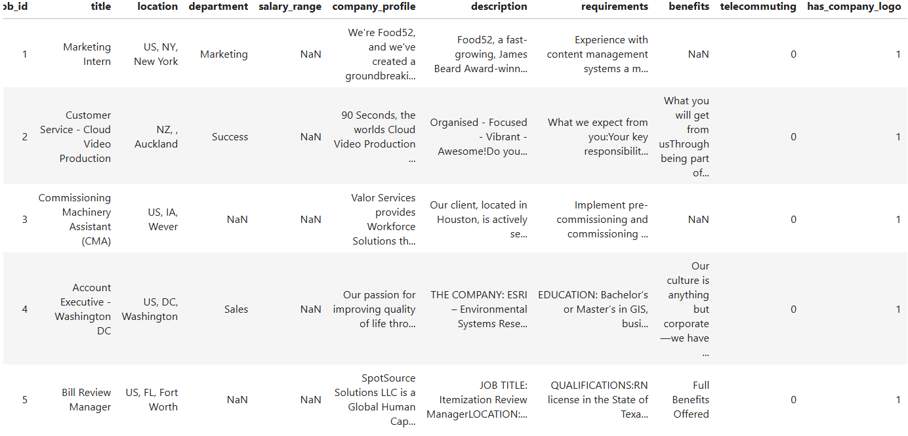
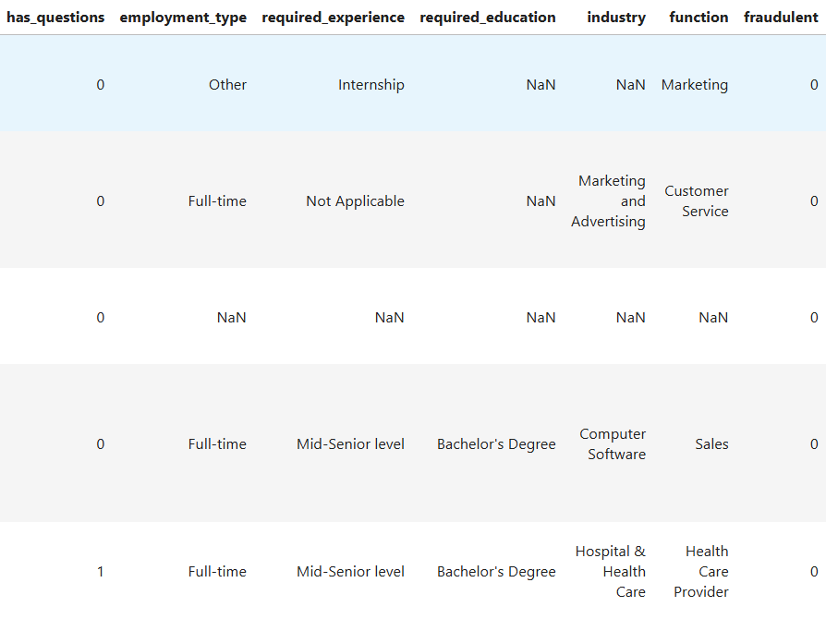
Dataset.
Source: Kaggle – Real or Fake Job Posting Prediction Dataset
Size: ~17 MB
Shape: 17,880 rows × 18 columns
Unit of Observation: Each row = one job posting
Notes:
“The dataset used in this project comes from Kaggle’s Real or Fake Job Posting dataset.
It contains approximately 17,880 job postings and 18 columns.
Each row represents a single job posting.
The dataset includes both textual features, such as job descriptions, and metadata features like employment type, salary range, telecommuting status, and company logo information.
This makes it suitable for both NLP-based and traditional machine learning models.”

Slide 5
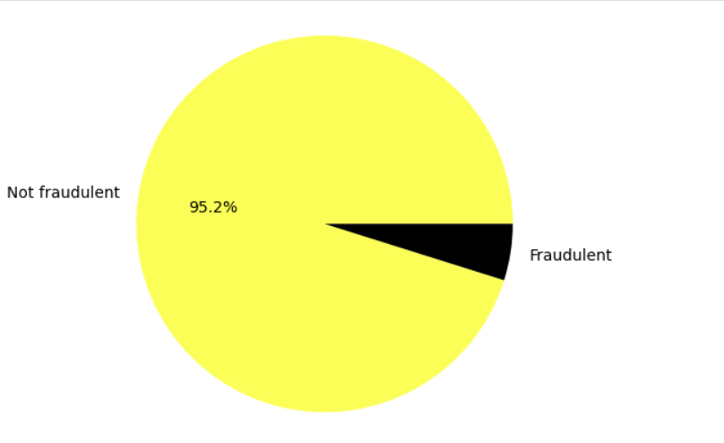
Exploratory data analysis
Notes:
“This pie chart shows the overall distribution of job postings in the dataset.
We can clearly see that the dataset is highly imbalanced.
About 95.2% of the postings are not fraudulent, while only a small percentage are fraudulent.
This is very common in fraud detection problems.
If we train models directly on this data, they may simply predict every job as real and still achieve high accuracy.
Because of this imbalance, handling class distribution became a critical step in my modeling process and later motivated the use of SMOTE.”

Slide 6
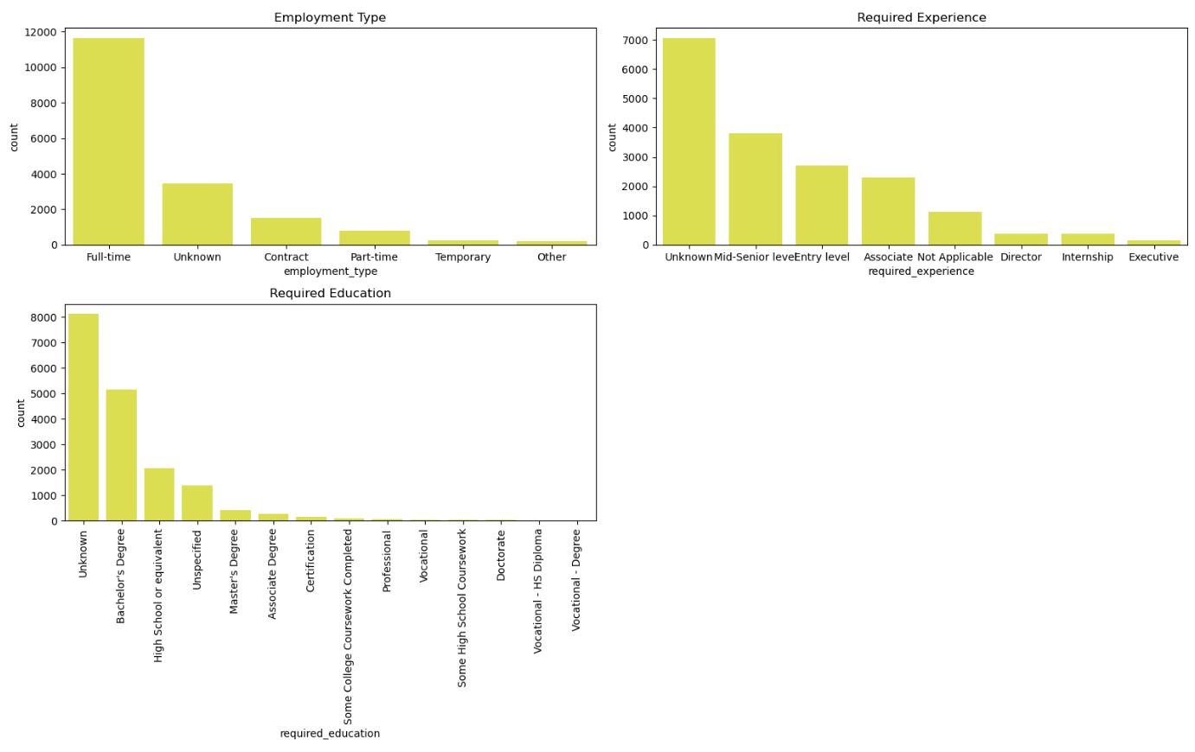
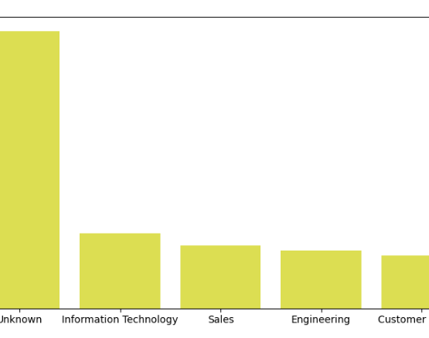
EDA
Notes:
“This slide shows the distribution of employment type, required experience, and required education.
Most postings are full-time, while contract, part-time, and temporary roles are much fewer.
A large number of postings also fall under ‘unknown’, which can be suspicious.
For experience and education, many postings do not clearly specify requirements.
Fraudulent postings often avoid being specific to attract a wider audience.
These patterns suggest that metadata features like experience and education play an important role in identifying fake job postings.”
“This bar chart shows job postings grouped by job function.
A large number of postings fall under ‘Unknown’, followed by Information Technology, Sales, Engineering, and Customer Service.
Fraudulent postings often target broad or entry-level roles such as customer service, where fewer technical details are required.
This insight shows that job function alone is not enough to detect fraud, but when combined with text features, it becomes very useful.”

Slide 7
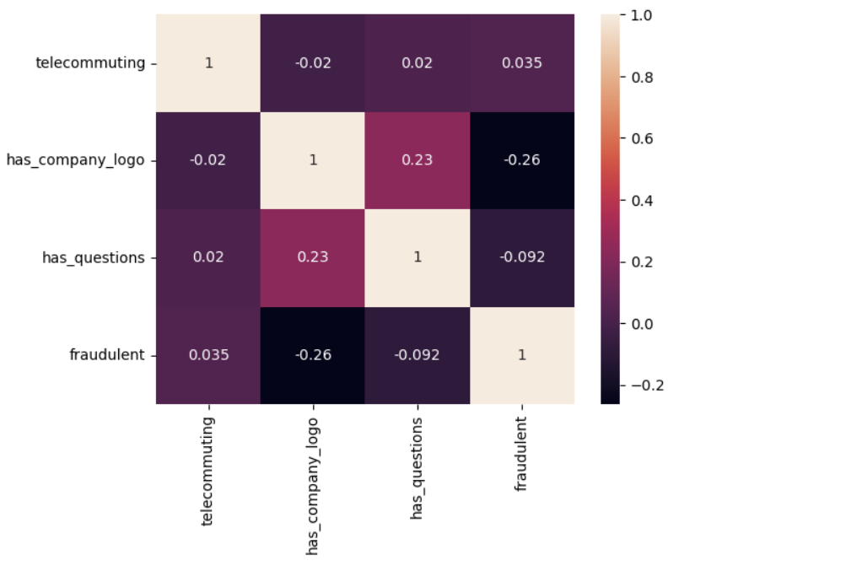
Heatmap
Notes:
“This heatmap shows correlations between numerical features and the fraud label.
We can observe that postings with a company logo are less likely to be fraudulent.
Similarly, postings with screening questions tend to be more legitimate.
However, correlations are not extremely strong, which indicates that fraud detection depends on a combination of features, not just one.
This supports the use of ensemble models like Random Forest and XGBoost, which can capture complex feature interactions.”

Slide 8
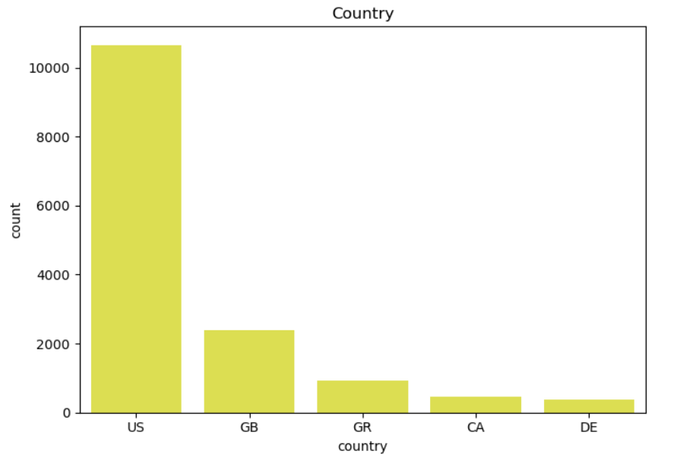
EDA
Notes:
“This slide shows the distribution of job postings by country.
Most postings come from the United States, followed by the United Kingdom and a few other countries.
While geographic information can be helpful, it must be used carefully to avoid bias.
Instead of using country as a direct decision factor, it was encoded and used as part of the overall feature set.”

Slide 9
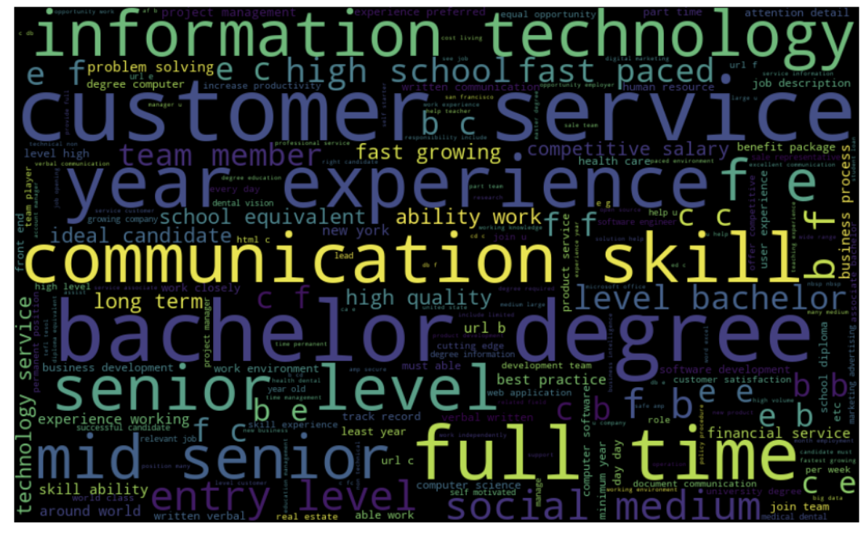
Word count
Notes:
“This word cloud visualizes the most frequent words in job postings.
Common words include ‘full-time’, ‘customer service’, ‘communication skills’, and ‘experience’.
Fraudulent postings often use vague and repetitive language, avoiding role-specific details.
Real job postings usually contain more structured and technical terminology.
This highlights why NLP plays a critical role in detecting fake job postings.”

Slide 10
One-Hot Encoding
Converted categorical columns, department, salary_range, employment_type, country into numerical format using One-Hot Encoding.
Ensured machine learning models can correctly interpret all non-text categorical variables.
Combined the one-hot encoded categorical features with the scaled numerical features (telecommuting, has_company_logo, has_questions) to create a unified preprocessed dataset ready for model training.
Applied the same preprocessing to both training and testing datasets for consistency.
Notes:
“Categorical features such as department, salary range, employment type, and country were converted into numerical values using One-Hot Encoding.
These encoded features were combined with scaled numerical features like telecommuting status and company logo presence.
The same preprocessing steps were applied to both training and testing datasets to ensure consistency.”

Slide 11
SMOTE (Synthetic Minority Oversampling Technique)
Addressed class imbalance in the dataset where fraudulent job postings were significantly fewer than real postings.
Applied SMOTE to the preprocessed training data to generate synthetic samples for the minority class.
Balanced the target variable by oversampling the fraudulent class, ensuring the model does not become biased toward predicting only real postings.
Used the balanced datasets (x_train_balanced, y_train_balanced) for training all machine learning models.
Verified the improvement by comparing class counts before and after SMOTE.
Notes:
“To address class imbalance, I applied SMOTE, which generates synthetic examples of the minority class.
SMOTE was applied only to the training data to prevent data leakage.
This helped the models learn patterns from both real and fake postings more effectively.”

Slide 12
Model Evaluation
Multiple classification algorithms were compared to identify the best-performing model:
Naive Bayes, K-Nearest Neighbors (KNN), Random Forest, Logistic Regression, and XGBoost.
Performance was assessed using standard evaluation metrics such as Accuracy, Precision, Recall, F1-Score.
The comparison allowed determining which model provides the most reliable and balanced performance for fraud detection.
Notes:
“I trained multiple machine learning models including Naive Bayes, KNN, Logistic Regression, Random Forest, and XGBoost.
Each model was evaluated using accuracy, precision, recall, and F1-score to determine the most reliable approach.”

Slide 13
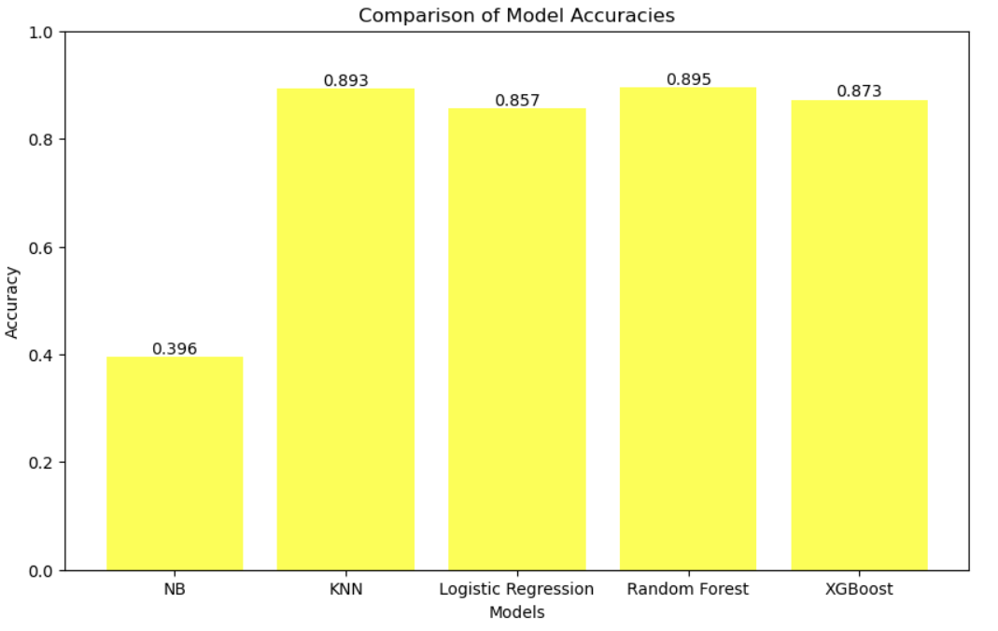
Model Accuracies
Notes:
“This graph compares model accuracies.
Naive Bayes performs poorly with around 39% accuracy.
KNN, Logistic Regression, Random Forest, and XGBoost perform significantly better between 85% and 89%.
Random Forest achieves the highest accuracy among classical models.”

Slide 14
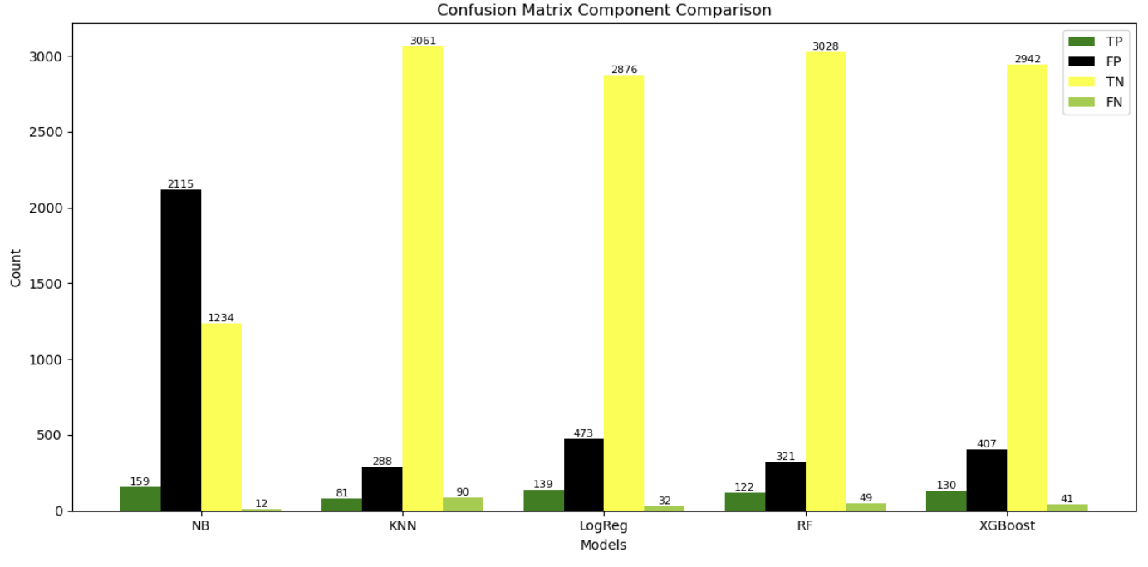
Notes:
“This slide compares confusion matrix components.
Naive Bayes has a very high number of false positives.
Random Forest and XGBoost show high true negatives and low false negatives.
This confirms that tree-based models provide more reliable predictions.”

Slide 15
LLM Embedding + Classical Classifier
Used a Sentence-Transformer model ( all-MiniLM-L6-v2) to convert the preprocessed job posting text into dense vector embeddings.
Trained traditional machine learning classifiers such as Logistic Regression, Random Forest, and XGBoost directly on these embeddings.
This approach provides a fast, low-resource alternative to full LLM fine-tuning while maintaining strong performance.
A fast, low-resource, and interpretable approach using LLM embeddings with classical classifiers. It enables quick training and deployment while allowing direct comparison with TF-IDF models, making it a strong baseline for fraud detection.
Notes:
“In addition to TF-IDF, I used Sentence Transformer embeddings from the all-MiniLM-L6-v2 model.
These embeddings capture semantic meaning and were used to train Logistic Regression, Random Forest, and XGBoost.
This approach provides strong performance with low computational cost.”

Slide 16
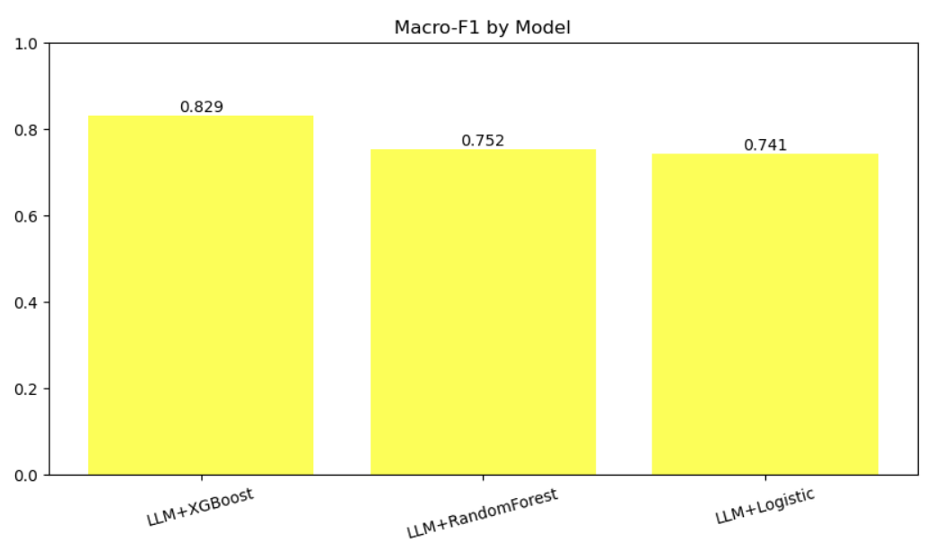
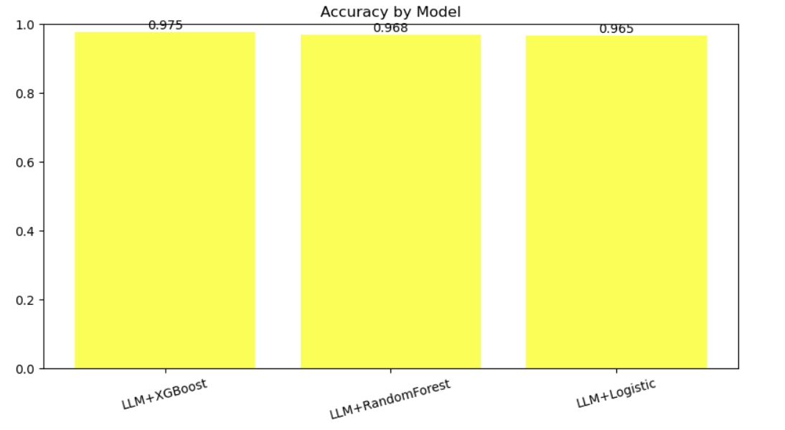
Notes:
“All LLM-based models achieve accuracies above 96%.
LLM + XGBoost performs the best with about 97.5% accuracy.”
“LLM + XGBoost also achieves the highest Macro-F1 score, indicating balanced performance across both classes.”

Slide 17
Future Scope
Deploy the model as a real-time web application or API for detecting fake job postings.
Explore advanced NLP models like BERT.
Continuously retrain the model with updated and larger datasets as fraud patterns evolve.
Notes:
“In the future, this model can be deployed as a real-time application or API.
More advanced models like BERT can be explored, and the system can be retrained as fraud patterns evolve.”

Slide 18

Thank You

